Slide 1
Section 6
The Internet

Slide 2
Topics covered
6.1 Components of the Internet
6.2 Internet addresses
6.3 Protocol applications
6.4 Distributed computing

Slide 3
6.1 Components of the Internet
The Internet - the “mother of all networks”
  a collection of thousands of networks
No one owns it
  – Originally developed by US department of defense (not commercially designed)
World wide web is a subset of the Internet
  Actually, a standard for displaying and transmitting information
Notes:
Internet - a worldwide network that connects hundreds of thousands of smaller networks.
780 Million Users estimated 2004. It took 91 years for telephones to grow as much and 54 years for TV
Information not organized, Information overload
www- Hypertext links between documents

Slide 4
History of Internet
ARPANET developed in 1969
  Designed to connect computers at four locations and be resistant to disruption
E-mail capability added in 1972
National Science Foundation connected its large network, NSFnet to ARPANET in 1986
Early 1990s Hypertext links added to documents and browser application developed
1994 World Wide Web consortium founded
Notes:
Arpnet connected 4 Universities in US. Funded by US Department of defence
Non commercial network and not proprietary
Once apon a time Novell, Apple, IBM all their own standards
Mosaic 1st browser
W3C standardise HTML and HTTP www.w3c.org

Slide 5
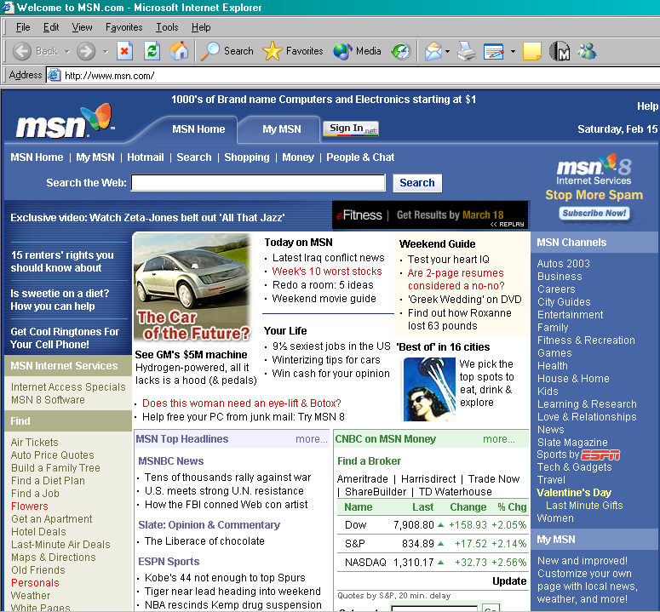
Browser
Interface software used to explore the Internet
  Early browsers were text-only
  Mosaic was the first graphical browser
Graphical browsers combine ease of links with attractive graphical interface
Notes:
Link is highlighted or different color and easy to see
Explorer from Microsoft
Homepage,
Title bar, menu (File, Edit, View, Favorities/bookmarks, Tools,Help) buttons (forward back reload etc), Address takes URL, Status bar
Moving earth and hour glass

Slide 6
Uniform Resource Locator (URL)
The complete, unique address of a Web page
  Web page URL begins with http
    HyperText Transfer Protocol – allows communication by using links to transfer data between sites
  Domain name – address of site’s host computer
    Last part of domain name is called a top-level domain
    Identifies country or purpose of organization
  URL – http://www.it.nuigalway.ie/home.html
  = Protocol // domain / file name
Notes:
HTTP – assume links. Assumed by browsers But can be part of unique address instead of www
Protocol, domain (computer address) and file Path
www.nuigalway.ie (if path left out then index.html is default
Used to be case sensitive (browser now compensates)
Top level domain (last 3 letters) used to organise sites
.com commercial, .org non profit organisations, .gov US government
Countries .ie ireland .uk UK

Slide 7
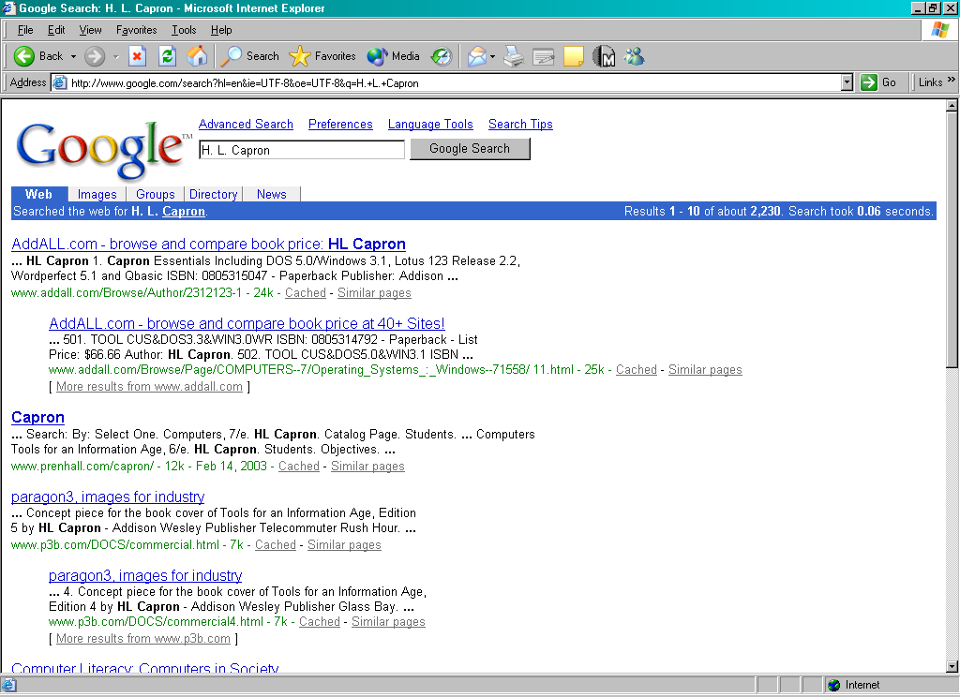
Searching the Internet
Search Engine – lets a user specify search terms
  Search engine builds database of sites that match those terms
  Uses spider software to build database
Internet directory – database is developed by human researchers rather than spider
Notes:
Helps users find documents on the web
Engine on its own web site
Spider/crawler searches other documents with links
Creates list of common words and inserts into database
Weights sites for words
www.Google.ie
www.yahoo.ie (UK and Ireland)
www.altavista.com

Slide 8
Connecting to the Internet
Large organization: buy a direct connection
Small organization or individual: link domain to the domain of an ISP
  ISP = Internet Service Provider
Individual: temporarily link computer into ISP’s domain

Slide 9
Intranets & Extranets
Intranet - an organization’s internal private network that uses the infrastructure and standards of the Internet and the WWW
Extranets - private intranets that connect not only internal personnel but also selected suppliers and other strategic parties
Notes:
Web server for their own organisation
Employee information
Forms and notices
Some can be made public
Firewall software that filters traffic passing through or to a machine. Covered next chapter

Slide 10
6.2 Internet Addressing
IP address = 32 bit identifier for a machine
  Network identifier = part assigned by ICANN
  Host address = part assigned by domain owner
Dotted decimal notation = standard for displaying IP addresses
  Example: 140.203.16.45
Notes:
Each computer on the internet has a unique address
2 parts to the address domain/network address and host address
140.203 - NUIG

Slide 11
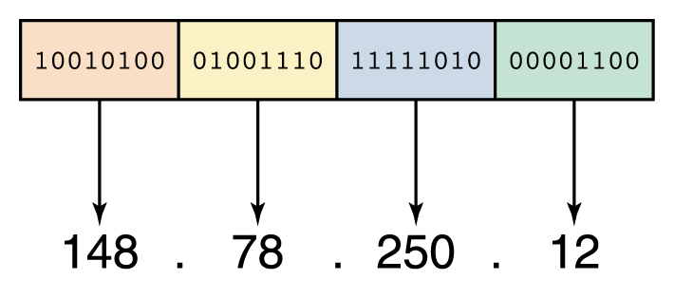
Network Addresses
An IP address can be split into
  network address, which specifies a specific network
  host number, which specifies a particular machine in that network
Figure 15.9
An IP address is stored in four bytes

Slide 12
Internet addressing: host names
Host name = mnemonic name
  Example: nuigalway.ie
  Domain name = part assigned by a registrar
    Top level domain = classification of domain owner
      By usage – Example: .com = commercial
      By country – Example: .ie = Ireland
  Subdomains and individual machine names
    Assigned by domain owner
    Domain owner must run a name server
      .
Notes:
Each domain address is unique and also has a unique domain name (nuigalway)
Domain Name server is translater
Has a directory which maps domain name to IP address
If DNS server cant resolve then it asks the next DNS server and so on

Slide 13
Domain Name System
A hostname consists of the computer name followed by the domain name
csc.villanova.edu is the domain name
  A domain name is separated into two or more sections that specify the organization, and possibly a subset of an organization, of which the computer is a part
  Two organizations can have a computer named the same thing because the domain name makes it clear which one is being referred to

Slide 14
Domain Name System
The domain name system (DNS) is chiefly used to translate hostnames into numeric IP addresses
  DNS is an example of a distributed database
  If that server can resolve the hostname, it does so
  If not, that server asks another domain name server

Slide 15
6.3 Protocol applications
E-Mail is the most commonly used feature of the Internet
Each network domain provides a mail server machine which handles email traffic.
E-mail client software runs on each individual computer

Slide 16
Mail Server
Collects and stores messages in mailbox
E-mail address consists of user name, followed by @ symbol, then domain name of mail server
“John.murphy@nuigalway.ie”

Slide 17
E-Mail Client Software
Allows you to manage your e-mail messages
Features
  Address books
  The ability to attach files
    Some e-mail servers block all attached files
  Filters
    Direct incoming e-mail to specific folders
    Block spam
Notes:
Microsoft – Outlook, Webmail – NUIG (http://webmail.nuigalway.ie)
Junk email – filters scans email and enclosed file for recognised junk terms (trained on existing junk)

Slide 18
File Transfer Protocol (FTP)
A protocol for transferring files among computers
FTP servers maintain collections of downloadable files
  Downloading can often be done anonymously, without logging in
Many FTP servers can be accessed through Web browser
Notes:
Used when downloading from web sites
Have to connect with userid/password Often hidden by using anonymous user ID
Freeware FTP Explorer - www.ftpx.com

Slide 19
Telnet
A protocol that allows remote users to log onto a host computer
  Users use their own PCs
  Users log in over the Internet
  Users’ experience is the same as if they were sitting at the host computer’s local terminal
Remote user typically has to have a user ID and password

Slide 20
eCommerce
Businesses selling goods to consumer
Business-to-Consumer B2C
Has received the most media attention
  Estimates of U.S. online sales
    $48 billion in 2002
    Projected $130 billion by 2006
Based on secure protocol for credit cards
  Secure Sockets Layer SSL
Notes:
Some companies just do eCommerce and just have stores (Amazon) No overheads of normal selling. DotCom Model
Established companies backup normal business with eCommerce

Slide 21
6.4 Distributed computing
Server
  Manages system resources; provides access to them through a well-defined communication interface
Client
  Uses communication interface to request resources; server responds to those requests
Current dominant model for distributed computing

Slide 22
N-Layer Client/Server Architecture
Three-layer architecture
  Divides application software into three tiers
    Data layer
    Business logic layer
    View layer
  Simplifies distributing or replicating application software across a network
N-layer architectures
  Employ more than three layers

Slide 23
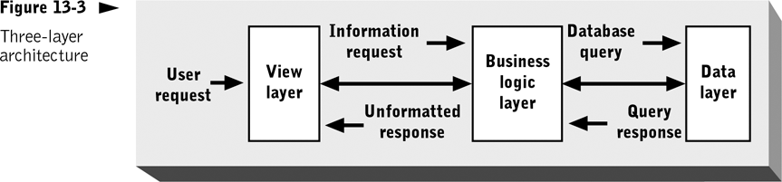
The view layer acts as a client of the business logic layer, which in turn acts as a client of the data layer.

Slide 24
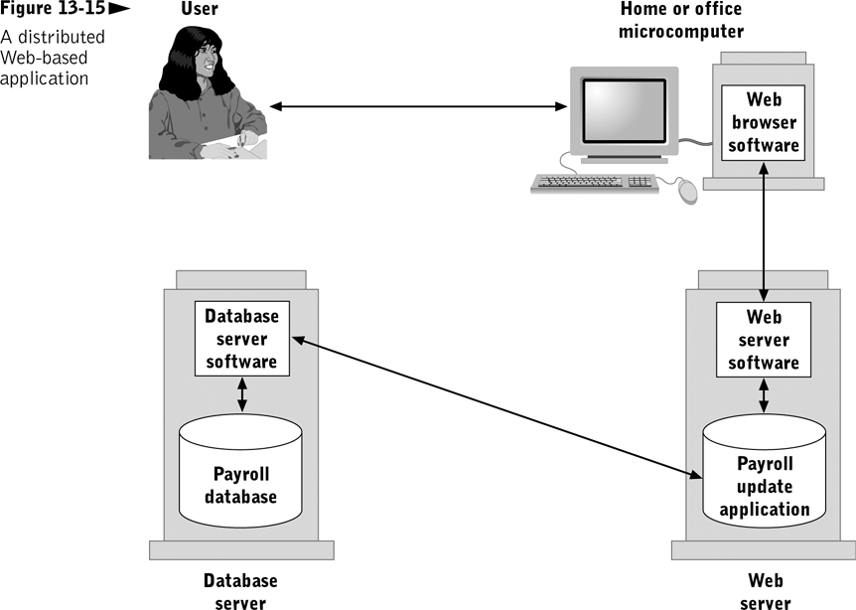

Slide 25
Components and Distributed Objects
Component
  Standardized, interchangeable software module that is executable, has a unique identifier, and has a well-known interface
Distributed object
  Cooperating process that implements a public interface to the services it provides

Slide 26
Connection Standards and Infrastructure
Interoperability requires well-defined and widely adopted standards
Standard network protocols do not address:
  Format and content of valid messages and responses
  Way to uniquely identify each component on the Internet and route messages to/from that computer
Additional standards provided by CORBA, COM+, SOAP, J2EE
Notes:
CORBA Specifies middleware used by objects to interact across networks
Key components
Object Request Broker (ORB)
Internet Inter-ORB Protocol (IIOP)
Robust, scalable, independent of programming language, OS, and CPU architecture
Disadvantage: Complexity
COM+ Like CORBA, defines component registration, message routing services, and component communication protocol
Unlike CORBA, components are not assigned permanent identifier, and are registered in Windows Registry of client machine where installed
Disadvantage: Dependence on propriety technology and limited support outside of Microsoft products
SOAP Attempts to address shortcomings of CORBA and COM+
Has few infrastructure requirements and relatively simple programming interface
Relies on existing Internet protocols
Disadvantage: Security and message delivery guarantees

Slide 27
Web software languages
Small programs can be downloaded to run in your browser
  Allow Web pages to perform many tasks
  Allow dynamic interaction
Come in several forms
  Scripting languages
    Produce instructions to be interpreted and executed by your browser
    JavaScript and VBScript are most common
  Programs embedded in Web page
    Java applets and ActiveX controls are most common
Notes:
HTML allows addional tags
Sun vs Microsoft

Slide 28
Dynamic web pages
Client-side
  Examples: java applets, javascript, Macromedia Flash
Server-side
  Common Gateway Interface (CGI)
  Java Servlets
  PHP

Slide 29
Current “Web” Related Research Areas
Information retrieval
Collaborative filtering
Data Mining

Slide 30
Collaborative Filtering
Introduced in the early 90’s
Collaborative filtering (CF)
  The method of making automatic predictions (filtering) about the interests of a user by collecting taste information from many users (collaborating).
Underlying Assumption
  Those who agreed in the past tend to agree again in the future.

Slide 31
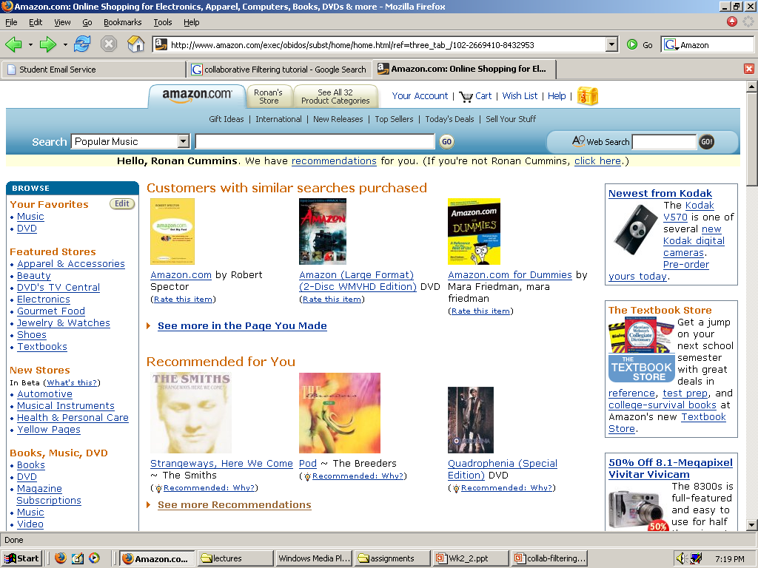
Current Uses- Amazon

Slide 32
Current Uses (2)
Systems for recommending items (e.g. books, movies, CD’s, web pages, newsgroup messages)
Many on-line stores provide recommendations (e.g. Amazon, CDNow).
Recommenders have been shown to substantially increase sales at on-line stores.

Slide 33
How to gather feedback
  Non-Intrusive
    Look at items searched for
    Stayed at certain items longer than others
    Items purchased
    Items put in wish list or added to shopping cart
    Other methods that may indicate a preference towards an item or group of items
  Intrusive
    Get user to rate items

Slide 34
Information Overload

Slide 35
Information Overload
The problem
  4 Billion URLs indexed by Google
  Web data is highly unstructured (written in natural language)
Possible approaches
  information retrieval
  document clustering
  visualization
  question answering
  text summarization

Slide 36
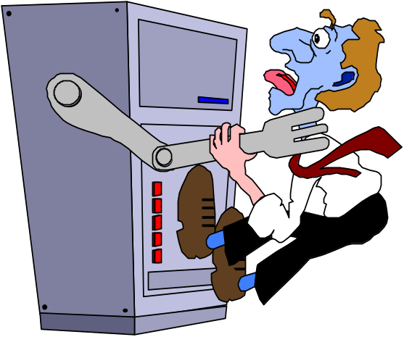
Motivation
In general, information overload is worsening
  no time to read everything
  vast amount of information available and accessible on-line
  labour-saving power search tools may increase, not reduce, available information
Need for tools which can help the user deal with large quantities of information

Slide 37
Consequences
Personal
  Time spent searching for information wasted
  Frustration while searching
  Inability to make decisive choices about items and information
Business
  Loss of time
  loss of money
Educational
  The ability to learn independently online gets increasingly more difficult

Slide 38
Information Retrieval (IR)
Deals with retrieving all relevant information given a user need (query) from unstructured text
IR | DBMS
Imprecise Semantics | Precise Semantics
Keyword search | SQL
Unstructured data format | Structured data
Read-Mostly. Add docs occasionally | Expect reasonable number of updates
Page through top n results | Generate full answer set

Slide 39
Traditional IR
Deals with Natural Language unstructured documents
60’s
Gerard Salton’s Vector Space Model (VSM) has been the basis for most search applications over the last 30 years.

Slide 40


Traditional IR Systems
Document
collection
IR
System
Query
1. Doc1
2. Doc2
3. Doc3
.
.
Ranked
Documents

Slide 41
Problems of Natural Language
“I saw the man on the hill with the telescope”. How many meanings?
Ordering of words is important for semantics.
  The dog bit the boy.
  The boy bit the dog.
Polysemy
  The same word can have many meanings
    “to wind a clock” and “the wind blows”
Synonomy
  Many words can have the same meaning
    Wrench and Spanner

Slide 42
IR and its uses
Became popular with the advent of the WWW (Google)
Digital Libraries
Legal experts might need to find all previously related cases regarding a certain case
Question answering systems
  One sentence answers
Does its part in fighting “Information Overload”

Slide 43
Multimedia IR
Semi-Structured IR (Web)
  Make use of title and limited structure
Music Retrieval
  Identify a song given a small sample
Video
Graphics
Text (of course)
Other types of Media

Slide 44
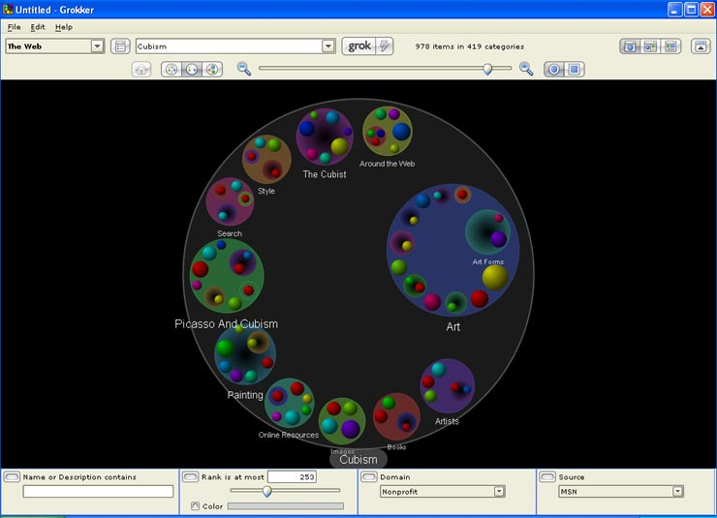
Visualisation Techniques (Grokker)

Slide 45
Text Retrieval
Deals with returning all relevant documents related to a given user need (query)
Relevance is a difficult concept to determine. However, most people know a relevant document when they see it.
In IR, relevance is usually taken to be objective.

Slide 46
Text retrieval Process
Preprocessing
Representation (term-weighting)
Comparison
Results
Reformulation (Feedback)

Slide 47
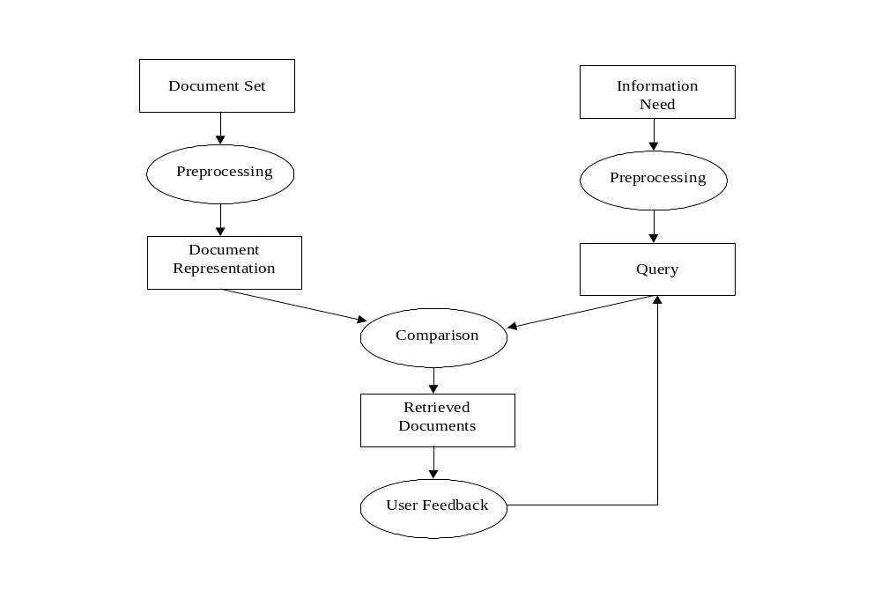
A typical IR system

Slide 48
Sample Document
16 × said
14 × McDonalds
12 × fat
11 × fries
8 × new
6 × company french nutrition
5 × food oil percent reduce taste Tuesday
…
McDonald's slims down spuds
Fast-food chain to reduce certain types of fat in its french fries with new cooking oil.
NEW YORK (CNN/Money) - McDonald's Corp. is cutting the amount of "bad" fat in its french fries nearly in half, the fast-food chain said Tuesday as it moves to make all its fried menu items healthier.
But does that mean the popular shoestring fries won't taste the same? The company says no. "It's a win-win for our customers because they are getting the same great french-fry taste along with an even healthier nutrition profile," said Mike Roberts, president of McDonald's USA.
But others are not so sure. McDonald's will not specifically discuss the kind of oil it plans to use, but at least one nutrition expert says playing with the formula could mean a different taste.
Shares of Oak Brook, Ill.-based McDonald's (MCD: down $0.54 to $23.22, Research, Estimates) were lower Tuesday afternoon. It was unclear Tuesday whether competitors Burger King and Wendy's International (WEN: down $0.80 to $34.91, Research, Estimates) would follow suit. Neither company could immediately be reached for comment.
…
“Bag of Words”

Slide 49
Pre-processing
Stop-word removal
  remove common words that have little or no semantic meaning (e.g. “the”, “a”, “of”)
  These words occur too frequently and in most documents to be of use
Advantages: It reducing the size of text to be processed. Stop-words take up a considerable amount of text in a document
It can leave some documents irretrievable

Slide 50
Stemming
Stemming algorithms remove common suffixes from terms occurring in documents
An example of a stem is the word “connect”, which is the stem for the variants “connected”, “connecting”, “connection” and “connections”.
It is worth noting that semantic information can be lost by stemming terms but in general stemming queries and documents does not damage and often improves the performance of IR systems, while at the same time decreasing the size of document collection

Slide 51
Representation (weighting)
Provide a weighting for terms based on some frequency characteristics (tf-idf)
Term-frequency
  A terms that occurs more frequently in a document is more likely to describe the content of that document
Inverse document frequency
  A term that occurs in few documents is better able to distinguish those documents from the rest of the collection

Slide 52
Representation (weighting)(2)
Length Normalisation
  Penalise overlong documents as they simply contain more words and may not be as relevant as shorter documents (which are more concise)

Slide 53
Comparison
Use the weighting scheme to compare each document to the query
Weight the terms that are in common to the query and document
Score each document in the collection and return a ranked list to the user

Slide 54
Ranked Lists
Popular way
to return
Results for VSM
Rank 1 (doc 9189) | 24.03
Rank 2 (doc 1254) | 23.28
Rank 2 (doc 17) | 22.21
Rank 4 (doc 702) | 17.25
Rank 5 (doc 224) | 15.23
Rank 6 (doc 41) | 12.33
Rank 7 (doc 14457) | 11.55
Rank 8 (doc 57125) | 11.12
Rank 9 (doc 25) | 10.89
Rank 10 (doc 5) | 10.87

Slide 55
Evaluation
How to evaluate systems?
How to tell if system A is better that system B.
Systems are usually tested on document test collections
Relevance is evaluated using a binary decision (i.e. relevant or not relevant)

Slide 56
Test collections
Test collections are usually comprised of 3 parts
  A set of documents (large sample, often up to a million or so nowadays)
  A set of queries
  Human judgements for the queries
    i.e. documents 400,10234 and 502344 are relevant to query 1

Slide 57
Evaluation metrics
Precision
  How accurate is the system?
  (# of relevant returned) / (# of returned documents)
Recall
  How many relevant documents has the system returned?
  (# of relevant returned) / (# of relevant documents in total)

Slide 58
Mean Average Precision (MAP)
Average precision (AP)
  For a query, for each relevant document retrieved calculate the precision and average over the number relevant found
Mean Average precision (MAP)
  Mean of the AP’s for a set of queries
  E.g. you could have a sample of 50 queries

Slide 59
What is Data Mining?
The automated extraction of hidden predictive information from (large) databases.
Three Main Points:
  Automated
  Hidden
  Predictive

Slide 60
Data, Information and Knowledge
Data is raw uninterpreted facts
  E.g. Book ( ISBN, Title, Author)
Information relates facts together
  E.g. Joe owns “To kill a mockingbird”
Knowledge relates Information and can make Inferences.
  E.g. Joe is 20 => Joe pays high car insurance

Slide 61
Motivation
Data volumes are too large for classical analysis approaches:
  Large number of records
  High dimensional data
    Many attributes (i.e. color, height, favourite food, bank balance)
How do you explore millions of records, tens or hundreds of fields to find patterns.

Slide 62
Motivation (2)
As databases grow, the ability to support the decision support process using traditional query languages becomes infeasible
  Many queries of interest are difficult to state in a query language (Query formulation problem)
  “find all cases of fraud??”
  “find all individuals likely to buy a FORD expedition??”
  “find all documents that are similar to this customers problem??”

Slide 63
Knowledge Discovery
The non-trivial process of identifying valid, novel, potentially useful, and ultimately understandable patterns in data.
The understandable patterns are used to:
  Make predictions or classifications about new data
  Explain existing data
  Summarize the contents of a large database to support decision making
  Graphical data visualization to aid humans in discovering deeper patterns

Slide 64
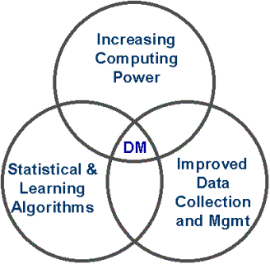
Why now?
Usually uses artificial intelligence techniques
Large amounts of data
  about people’s trends and
  transactions are available
Have become viable with
  the increase in processing
  power
http://www.thearling.com/dmintro/dmintro_2.htm

Slide 65
A Working Definition
Data Mining is a “decision support” process which searches for patterns of information in data.
Data Mining is a process of discovering advantageous patterns in data.
A pattern is a conservative statement about a probability distribution:
  A pattern is a natural or chance configuration, a reliable sample of traits, acts, tendencies, or other observable characteristics of a person, group, or institution

Slide 66
Predictive Nature
age
Black Box
predictor
bank details
Will the person
buy a car soon?
height

Slide 67
What sort of Data?
Relational Databases
Temporal or Spatial
Object Oriented Databases
Text, HTML data.
Multimedia
  Video
  Pictures
  Sound bytes

Slide 68
What do they know?
Bank details
  Balance, credit history, etc.
Insurance details
  likely-hood of accidents, etc.
Gmail, Yahoo, etc.
  Can archive all your mail and personal details
Colleges
  what courses your doing, your grades, sport clubs and socs etc.

Slide 69
Applications
Market analysis
  advertising and promotions can be targeted
Risk analysis and management
  Developing models for credit control. Will Customer A pay back a €100,000 loan?
  Profiles of customers: demographic distributions, the profitability of different market segments.
  Analyze the performance of various banking channels, such as phone or online banking.
Fraud detection and detection of unusual patterns

Slide 70
Applications (2)
Text mining (news group, email, documents) and Web mining
Stream data mining
DNA and bio-data analysis
Insurance
  To better understand the risk a customer poses.
  Age? Demographic background?

Slide 71
Market Analysis
Where does the data come from?
  Credit card transactions, loyalty cards, discount coupons, customer complaint calls, plus (public) lifestyle studies
Target marketing
  Find clusters of “model” customers who share the same characteristics: interest, income level, spending habits, etc.
  Determine customer purchasing patterns over time
Cross-market analysis
  Associations/co-relations between product sales
Customer profiling
  What types of customers buy what products Customer requirement analysis
  identifying the best products for different customers
  Predict what factors will attract new customers)

Slide 72
Risk Management
Finance planning and asset evaluation
  cash flow analysis and prediction
  contingent claim analysis to evaluate assets
  cross-sectional and time series analysis (financial-ratio, trend analysis, etc.)
Resource planning
  summarize and compare the resources and spending
Competition
  monitor competitors and market directions
  group customers into classes and a class-based pricing procedure
  set pricing strategy in a highly competitive market

